Slide 1
HACKATHON
ZERO HUNGER: RICE CROP DISEASE DETECTION WEB APGE

Slide 2
WHY ONLY RICE CROP:
RICE IS ONE OF THE MOST IMPORTANT STAPLE FOOD CROPS IN THE WORLD
PRIMARY FOOD SOURCE FOR OVER 3.5 BILLION PEOPLE, NEARLY HALF THE GLOBAL POPULATION
A MAJOR SOURCE OF INCOME AND EMPLOYMENT IN RURAL AREAS.

Slide 3
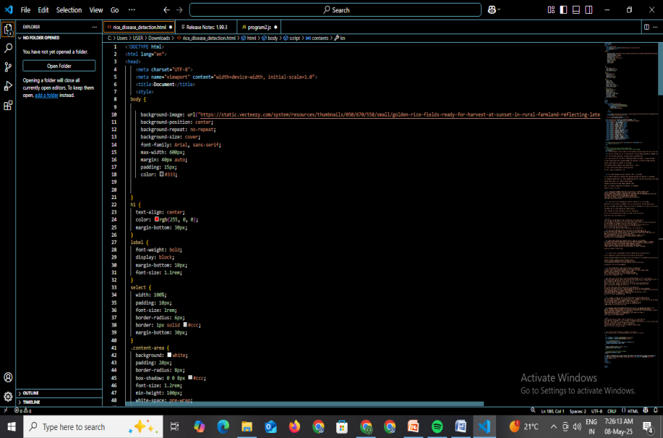
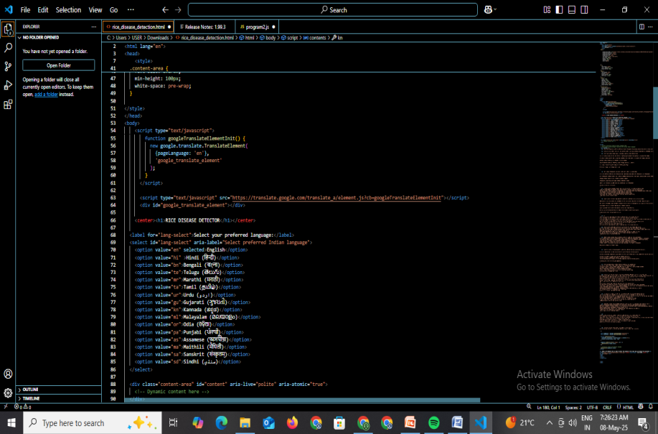
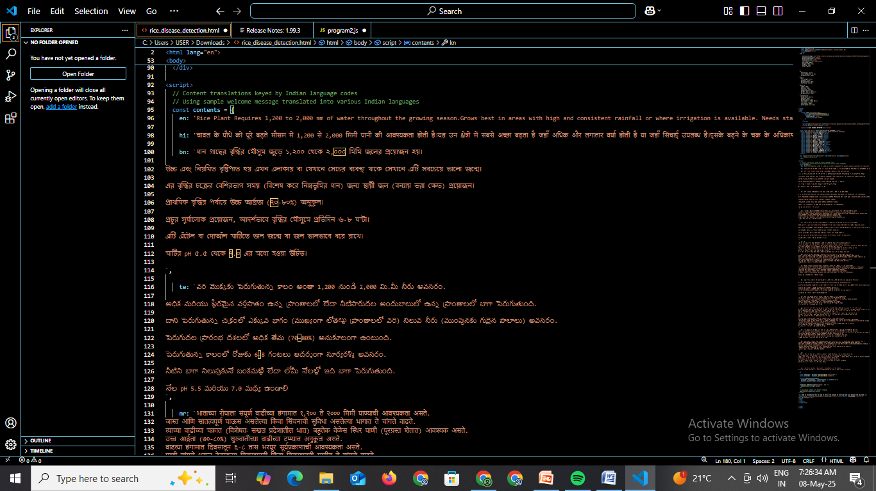
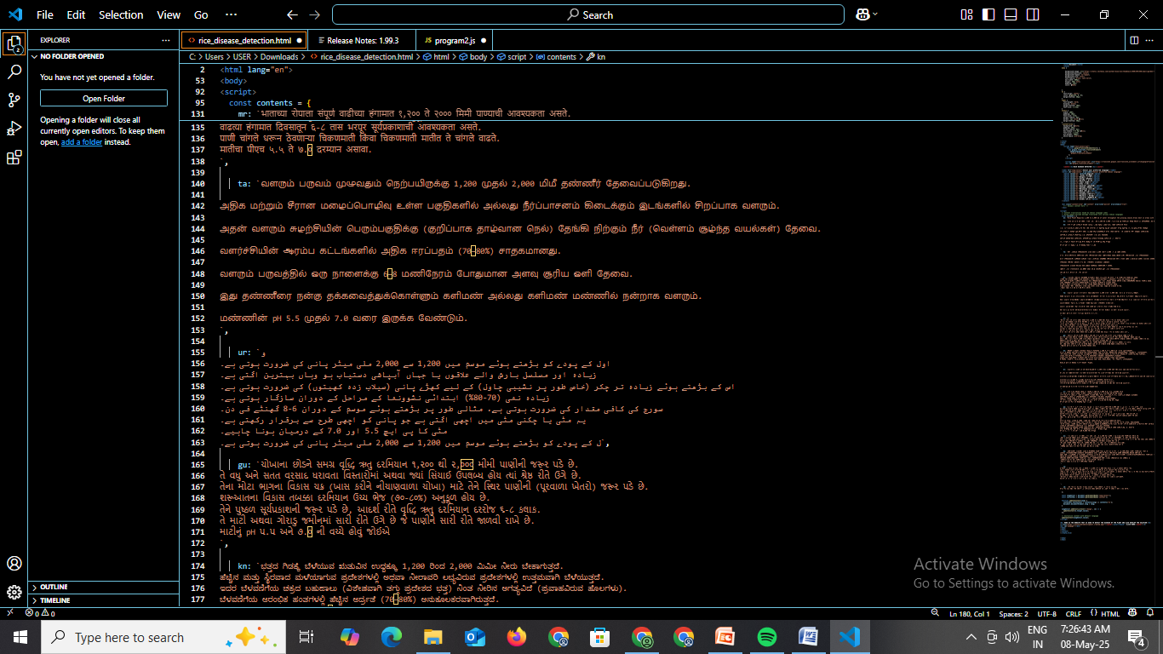
CODE IMPLEMENTAION

Slide 4
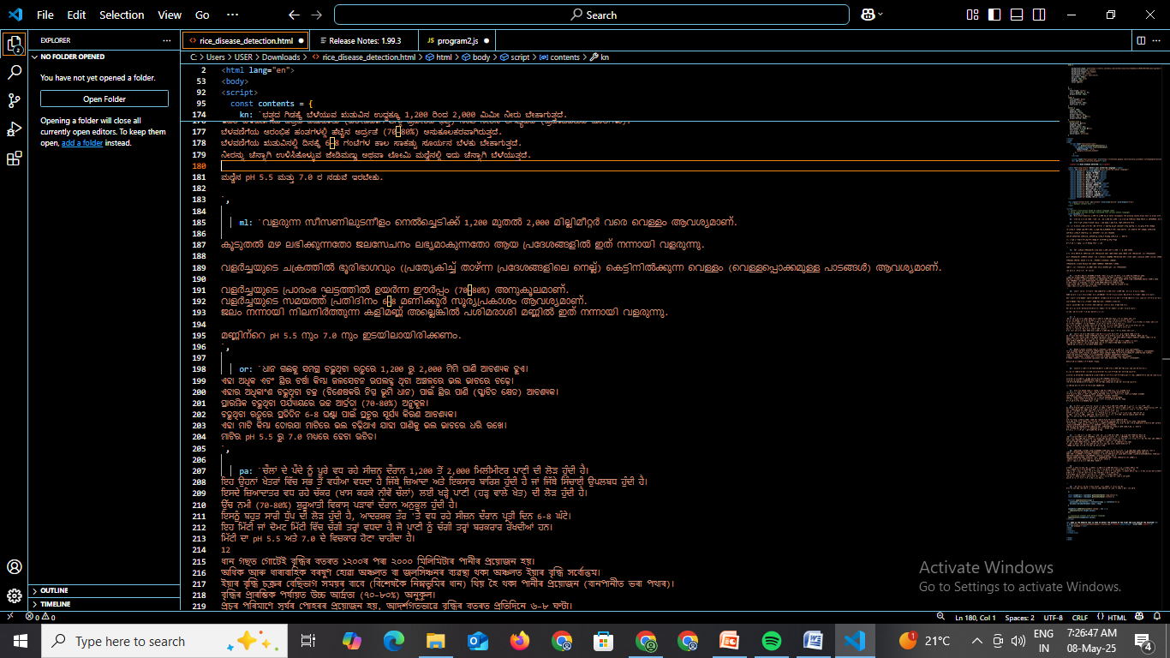
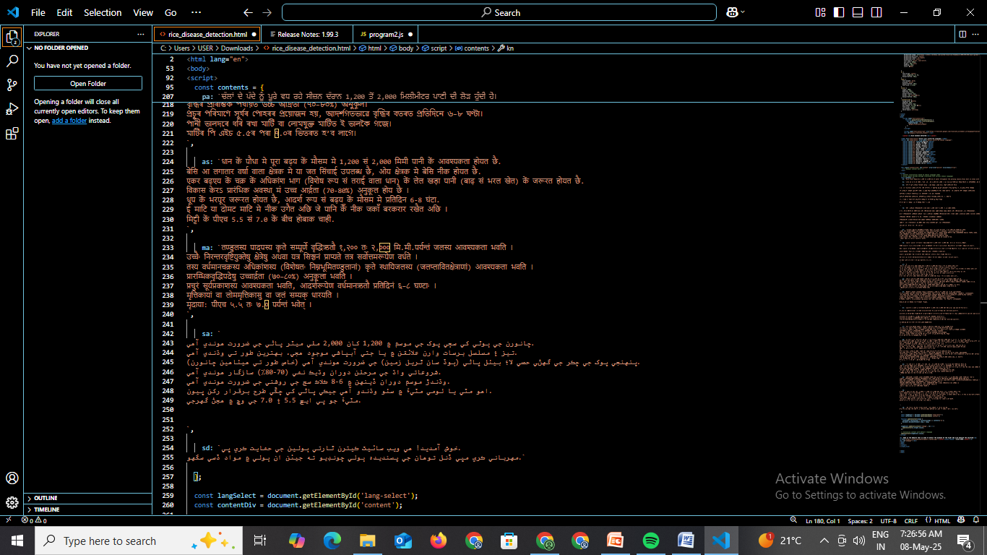
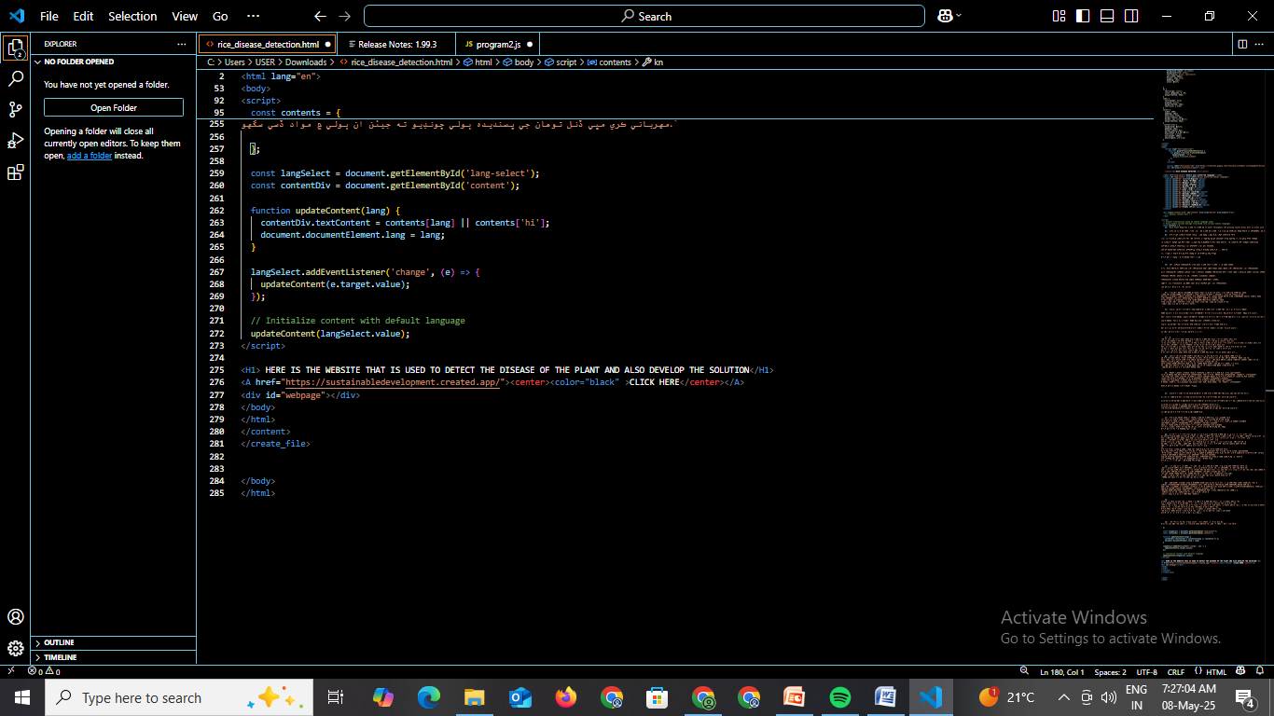
CODE IMPLEMENTAION

Slide 5
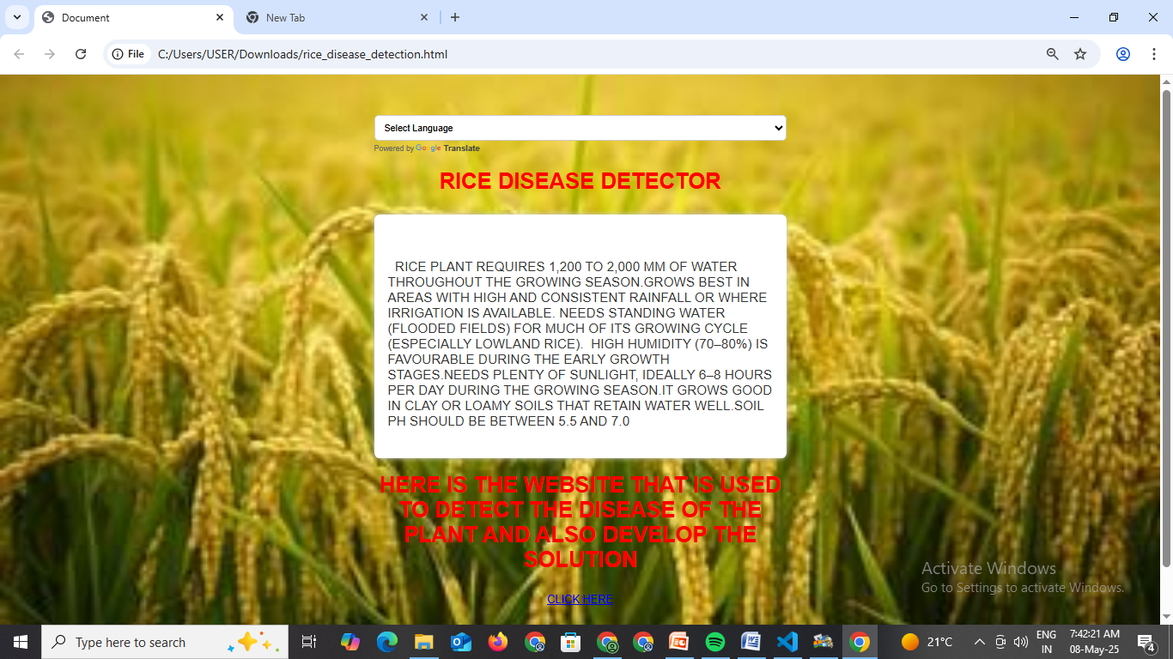
OUTPUT

Slide 6
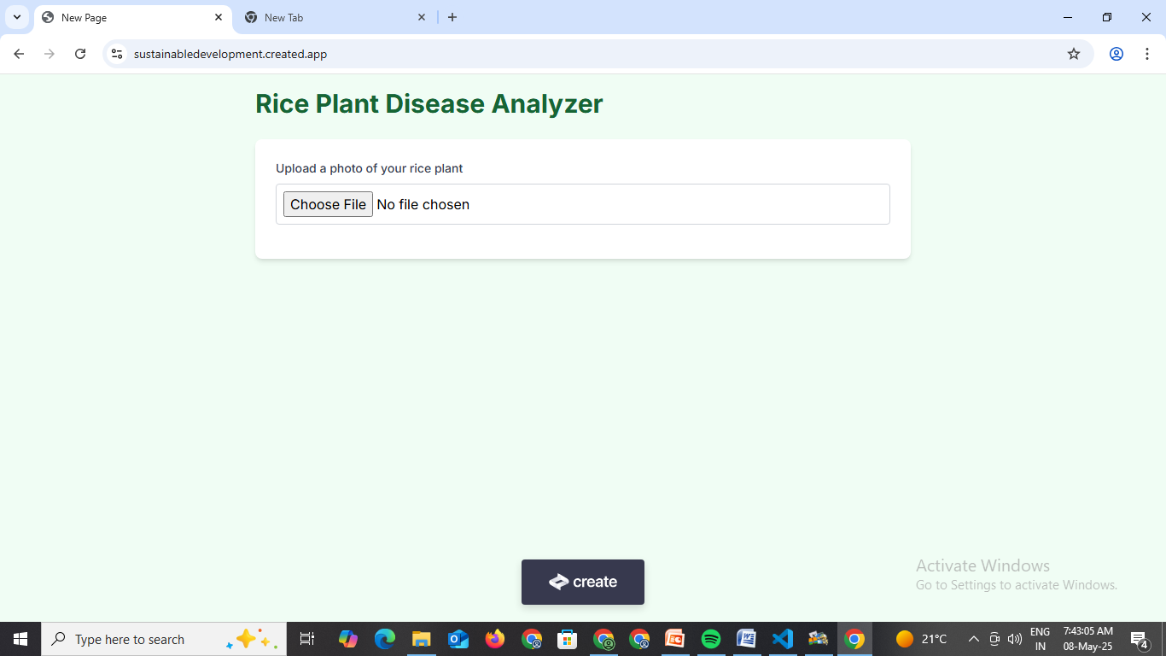
OUTPUT

Slide 7
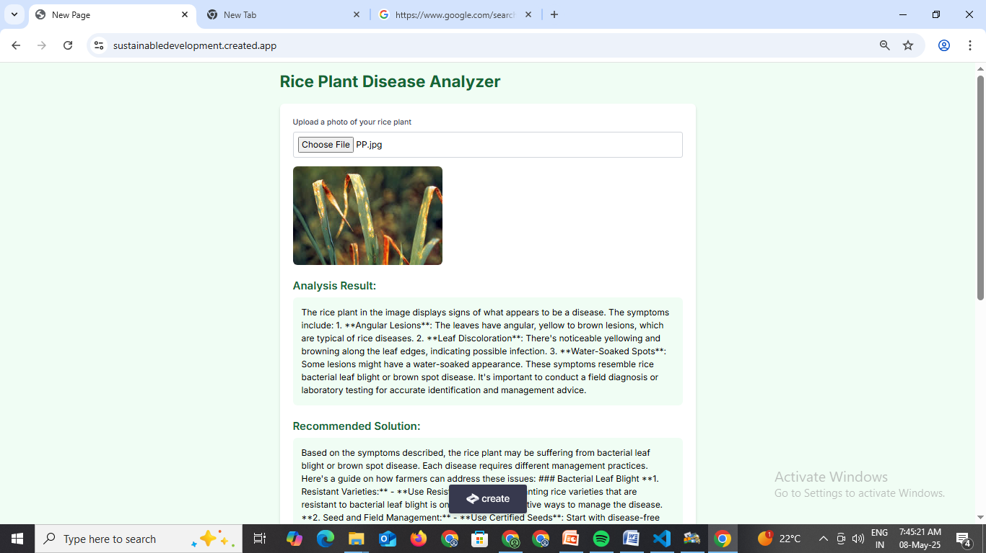
OUTPUT

